Slide 1



Scaling Qubit Readout with Hardware Efficient Machine Learning Architectures
ISCA - 50
Satvik Maurya (UW-Madison)
Chaithanya N. Mude (UW-Madison)
William D. Oliver (MIT)
Benjamin Lienhard (Princeton)
Swamit Tannu (UW-Madison)

Slide 2

Qubit Readout
Qubit Readout
ADCs
FPGA/ASIC
Qubits
Qubit Control
DACs
Qubit Control: Manipulates the state of the qubits
Qubit Readout: Measures the state of the qubits (0/1)
WRITE
READ
Notes:
Readout is a fundamental operation in quantum computing, it involves reading the state of a qubit by sensing a very small analog signal that is digitized by an ADC. Control is the reverse operation that writes a state onto a qubit.

Slide 3
Readout Error Rates are High!
Focus: Improving readout state classification.
Quantum Volume
Notes:
Readout is the noisiest operation on current quantum computers as shown in this chart which plots the worst case readout error for different IBM quantum computers. Readout consists of many components and we will be focusing on the signal processing part which is state classification.

Slide 4
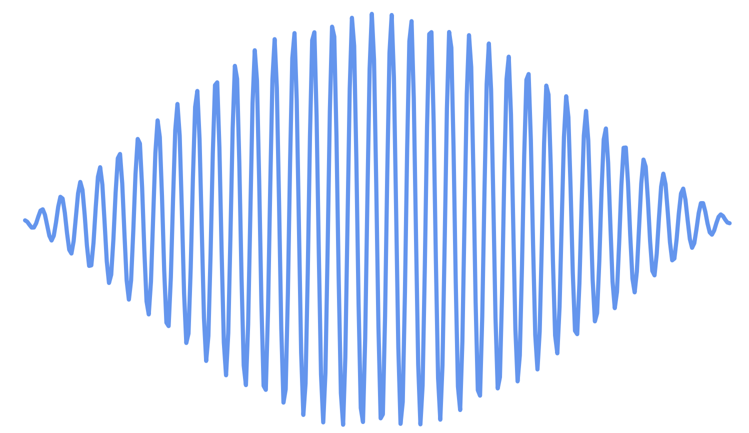
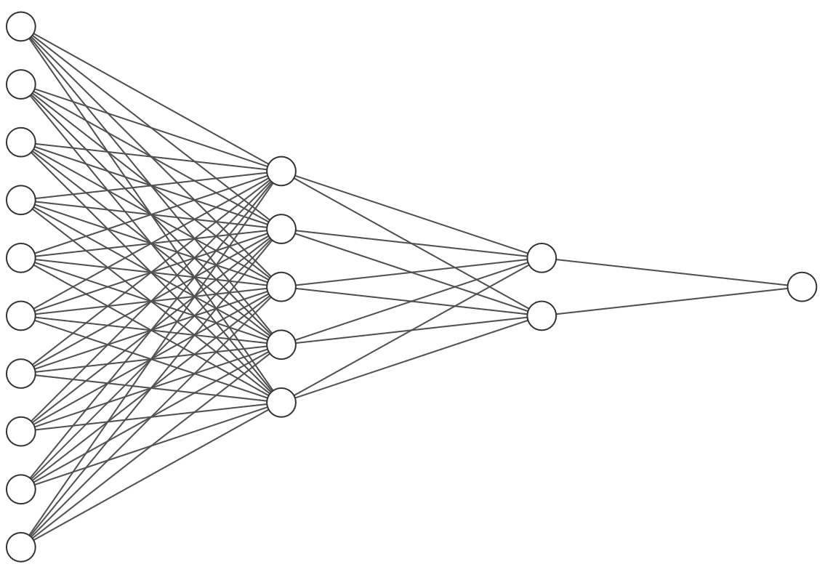
Current State-of-the-Art Classifier
Readout signal
A state-dependent readout signal is acquired from the qubits that is digitized by an Analog-to-Digital Converter.
This digitized data is used for state classification.
Qubits
ADC
Qubit state classifier
0/1
Time
dependent
signal
1000 sample buffer
Multiplexed readout
Signal
(5 qubits)
ADC
0 to 31
>½ million parameters!
Baseline¹ Classifier Design
¹Lienhard, Benjamin, et al. "Deep-neural-network discrimination of multiplexed superconducting-qubit states." Physical Review Applied 17.1 (2022): 014024.
Notes:
Before I present our proposed design, I’d like to talk about the current state of the art classifier and the advantages and disadvantages it offers.
Typical readout pipeline
Baseline design that uses all possible features of the readout signal by buffering the digitized samples and feeding them all to a very large neural network.

Slide 5
Current State-of-the-Art Classifier
1000 sample buffer
Multiplexed readout
Signal
(5 qubits)
ADC
0 - 31
>½ million parameters!
But…..
Up to 25% reduction in state assignment error rate compared to contemporary classifiers.
Up to 10x reduction in readout crosstalk.
High hardware complexity (>100% LUT utilization on Xilinx MPSoCs)
Slow if implemented in software
Notes:
The baseline design offers significant improvement in classification accuracy, and mitigation of readout crosstalk.
However, this classifier cannot be efficiently implemented on hardware, and will be very slow if implemented in software because of the overhead of transferring all the samples to software

Slide 6
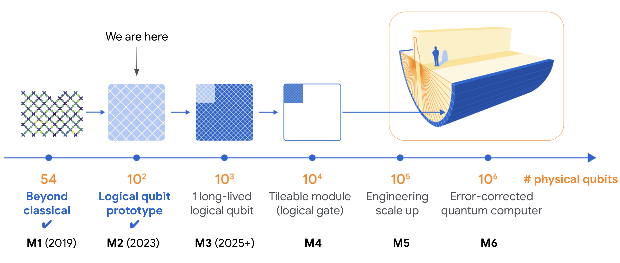

Control Hardware Must Be Scaled Too!
Number of FPGA scaling linearly with qubits is not sustainable
~30 FPGAs
??? FPGAs
https://ai.googleblog.com/2023/02/suppressing-quantum-errors-by-scaling.html
Notes:
The reason we want classifiers and other components involved in qubit control and readout to scale well is because control hardware must be scaled along with the number of qubits.
This roadmap was published by google and IBM has a similar timeline for scaling their systems and if we consider the 54 qubit system that Google used for their supremacy experiment, the number of FPGAs needed was quite large. If we continue with the same linear scaling, the control hardware needed for 10000 qubits would be very costly and complex.

Slide 7
Can we reduce the hardware complexity of the baseline classifier while retaining its benefits?
Notes:
And so, the key question we wanted to answer was whether we could create a more scalable, hardware-efficient classifier that would still retain all the benefits of the state-of-the-art.

Slide 8
Goal – Reduce Classifier Hardware Complexity
Hardware classifiers
Software classifiers
Retain crosstalk mitigation advantages offered by neural networks.
Reduce hardware complexity.
IBM hardware classifier
Readout Error
Large FNN Classifier (baseline)
Classification latency /
Hardware complexity
Notes:
This slide also visualizes our goal. We want to decrease the readout error and decrease the latency and hardware complexity of the classifier.

Slide 9
Visualizing Readout
Inphase (I)
Qubits
ADC
Quadrature (Q)
The readout signal is received from the qubits is a continuous time signal of duration > 100ns.
The readout signal is split into two channels – Inphase (I) and Quadrature (Q).
Notes:
So how do we do this? We can start by visualizing the readout process.

Slide 10
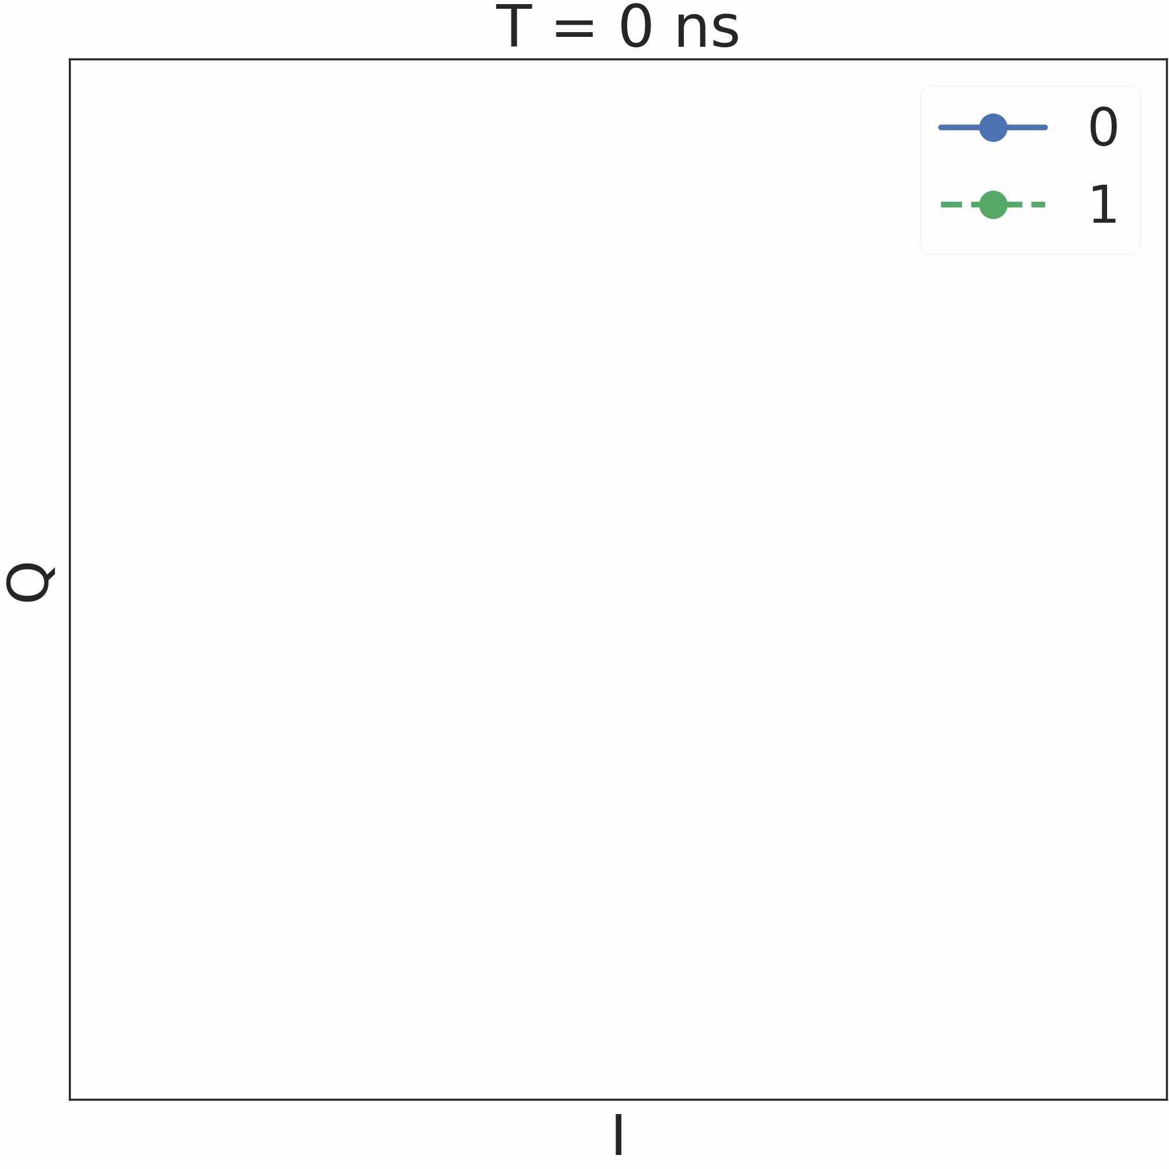
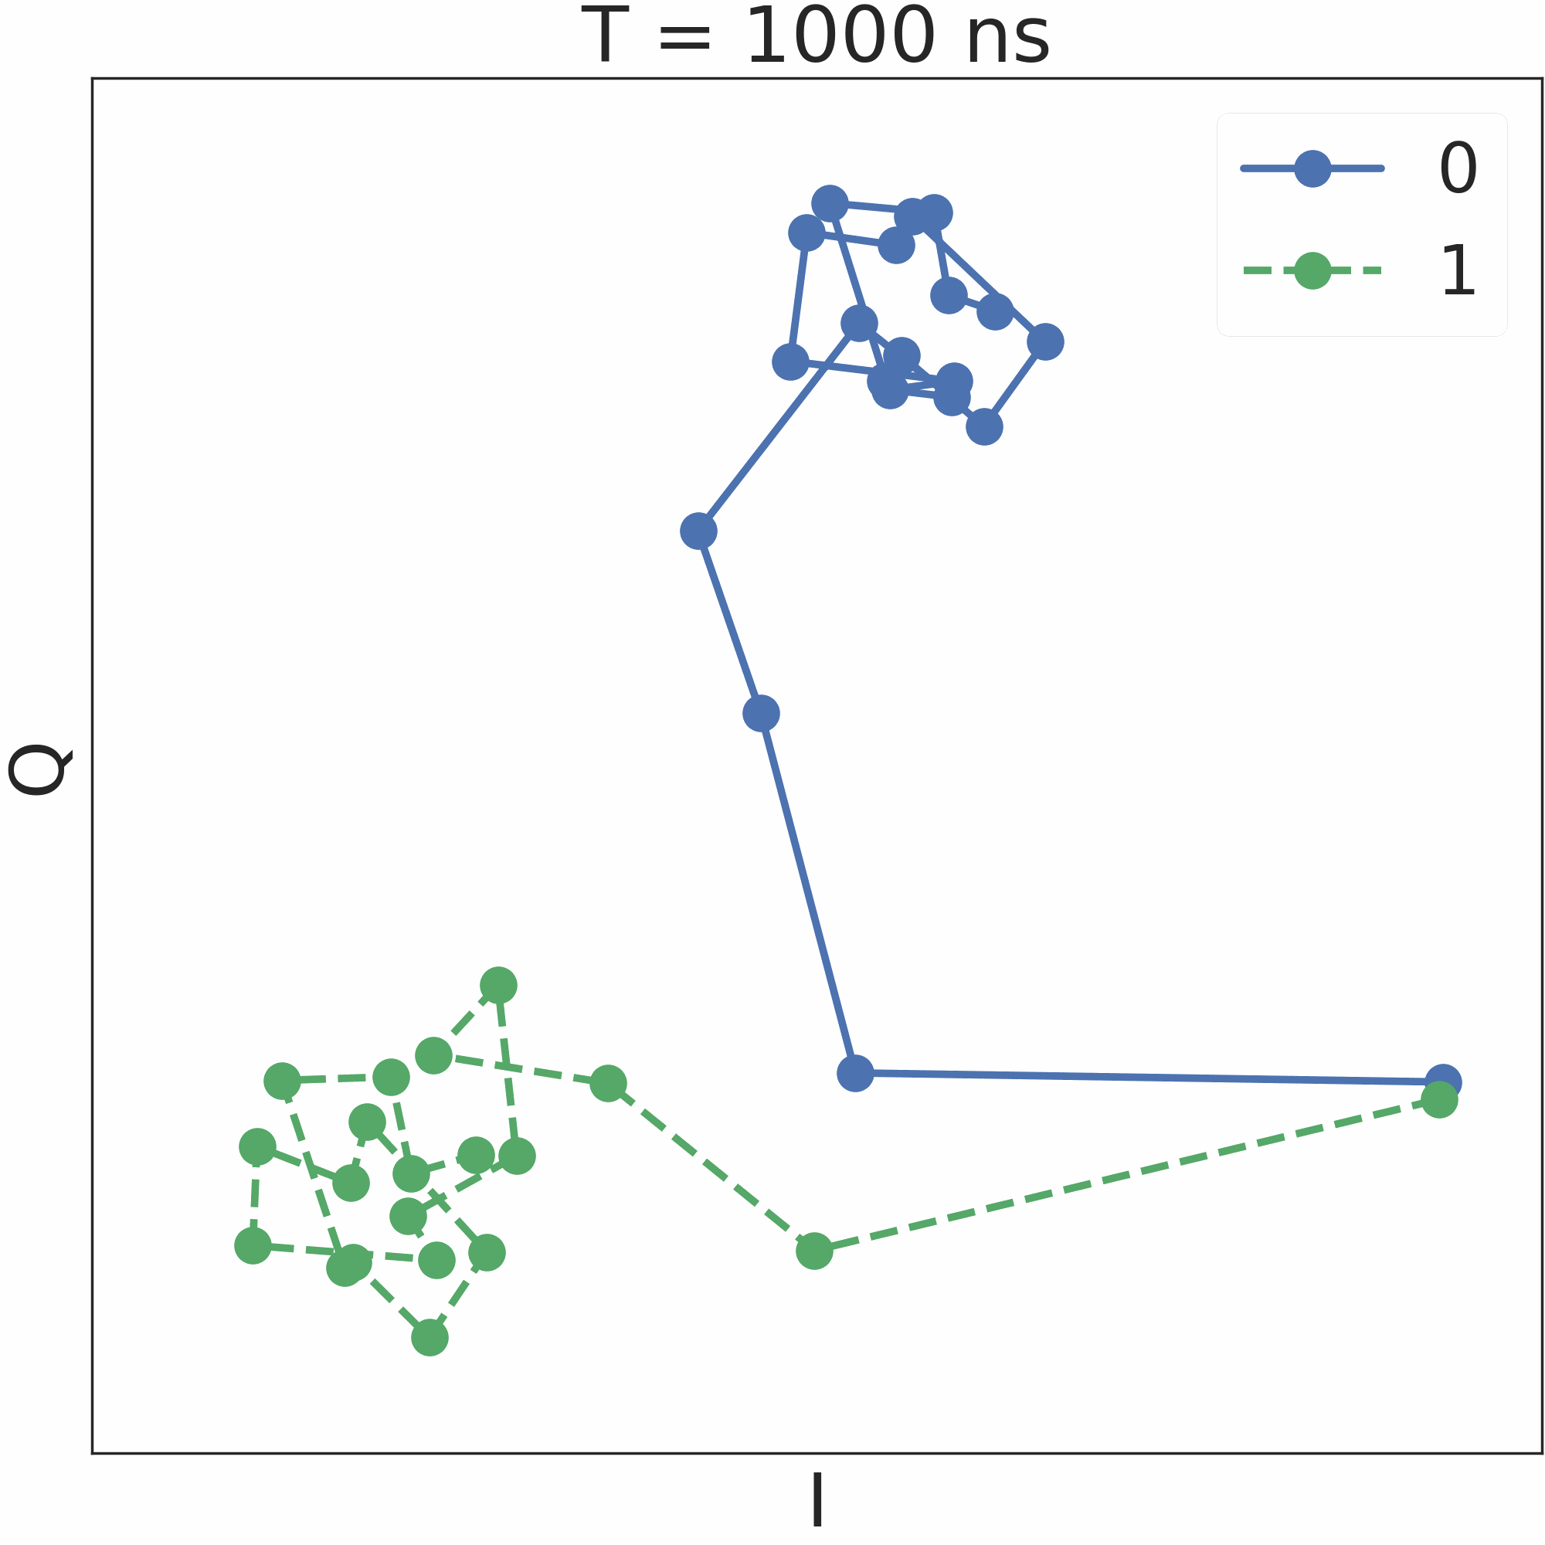
Visualizing Readout
Inphase (I)
Qubits
ADC
Quadrature (Q)
The readout signal is received from the qubits is a continuous time signal of duration > 100ns.
The readout signal is split into two channels – Inphase (I) and Quadrature (Q).

Slide 11
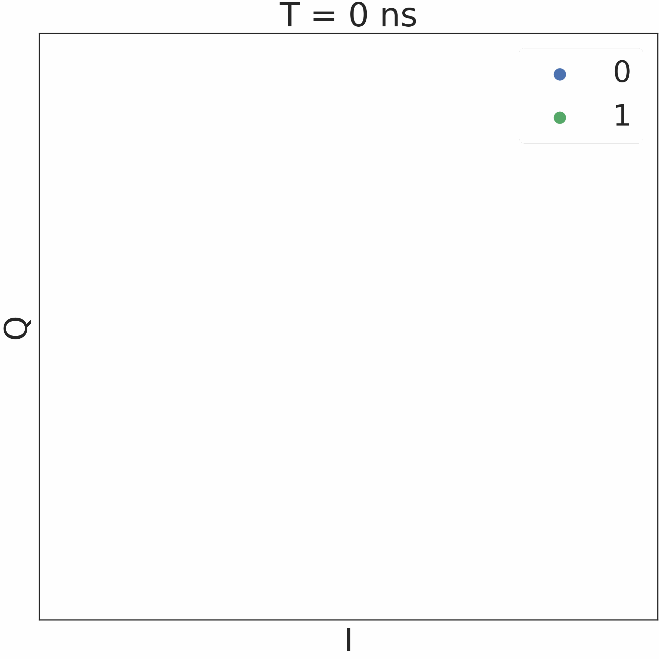
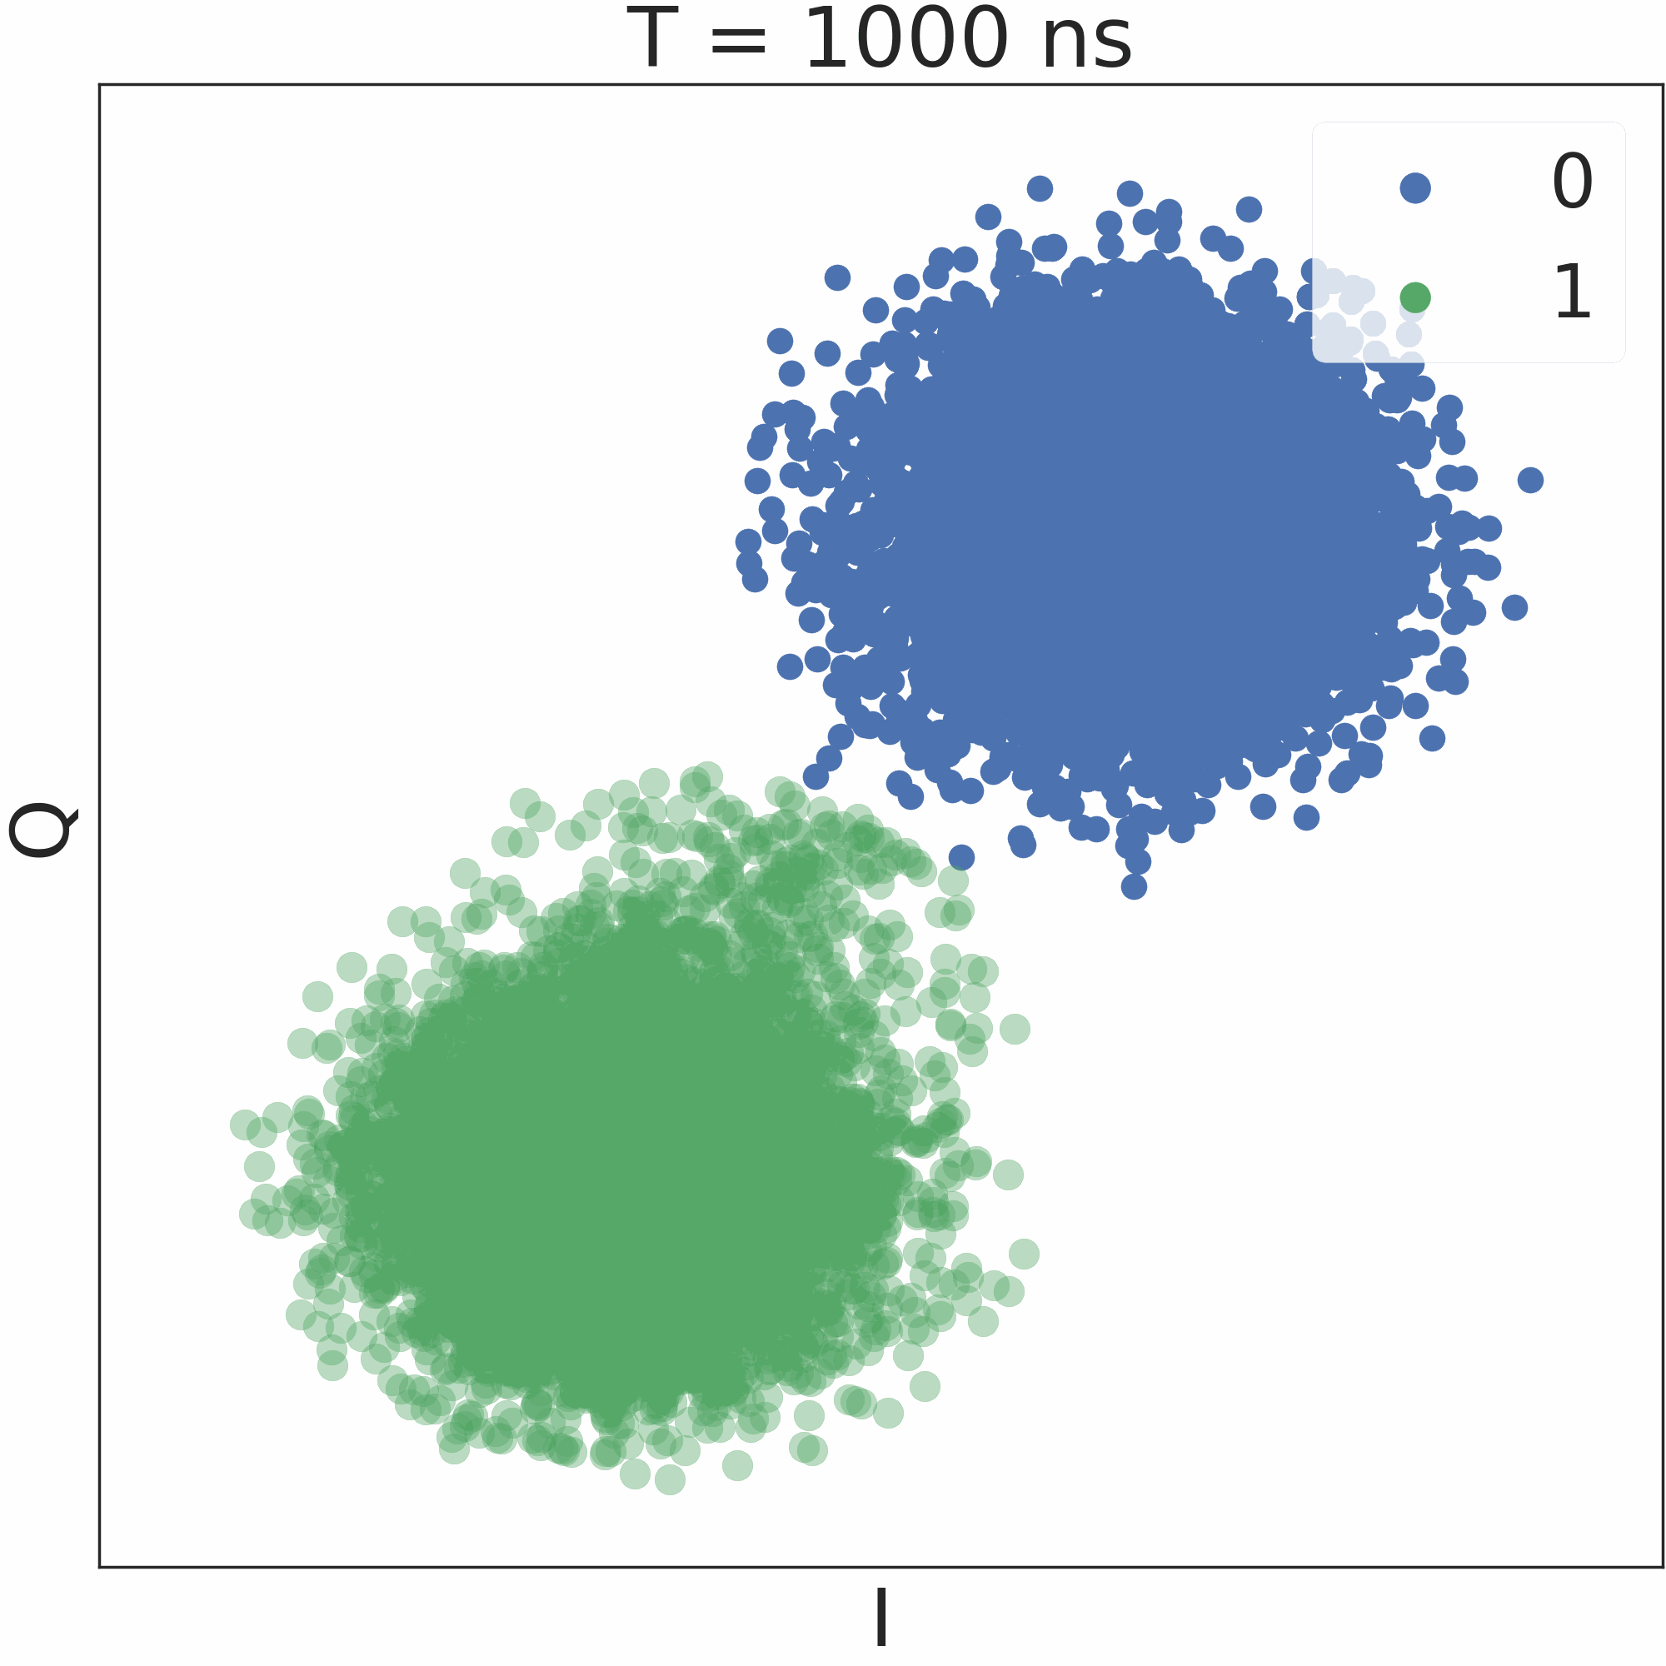
Visualizing Readout
(Ideal)
1000s of shots
I
Qubits
ADC
Filter
Classifier
Q
The readout signal is received from the qubits is a continuous time signal of duration > 100ns.
The readout signal is split into two channels – Inphase (I) and Quadrature (Q).
Filtering reduces the dimension of the input signal – usually an averaging filter.

Slide 12
Relaxations: Major Source of Readout Errors
(Reality)
Qubits prepared in state ‘1’ relax back to the ground state during readout

Slide 13
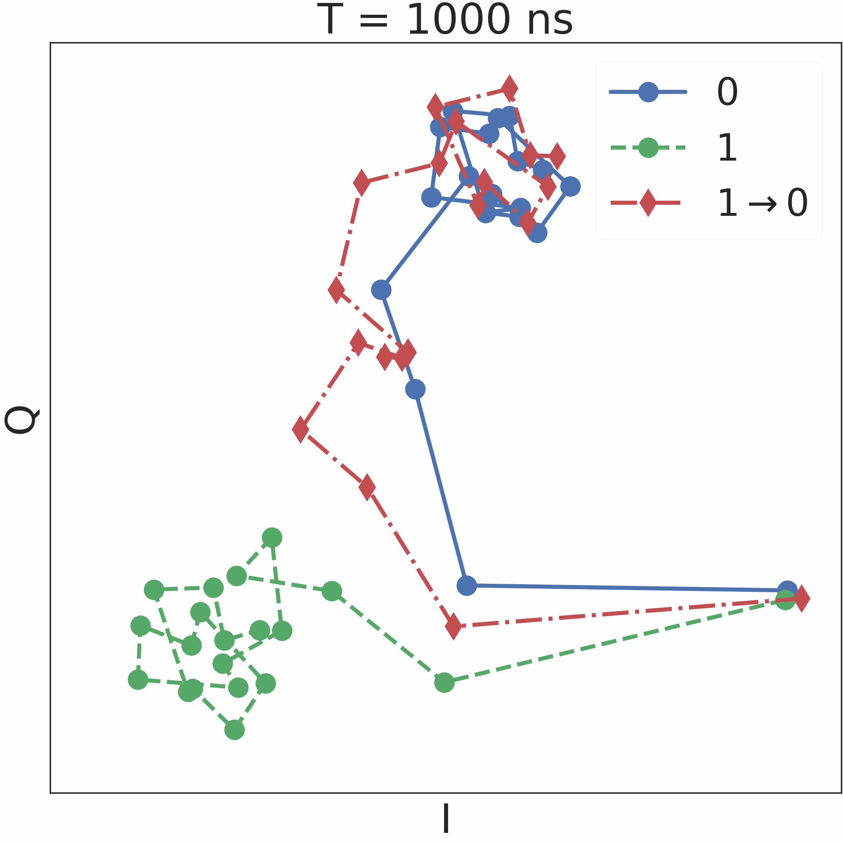
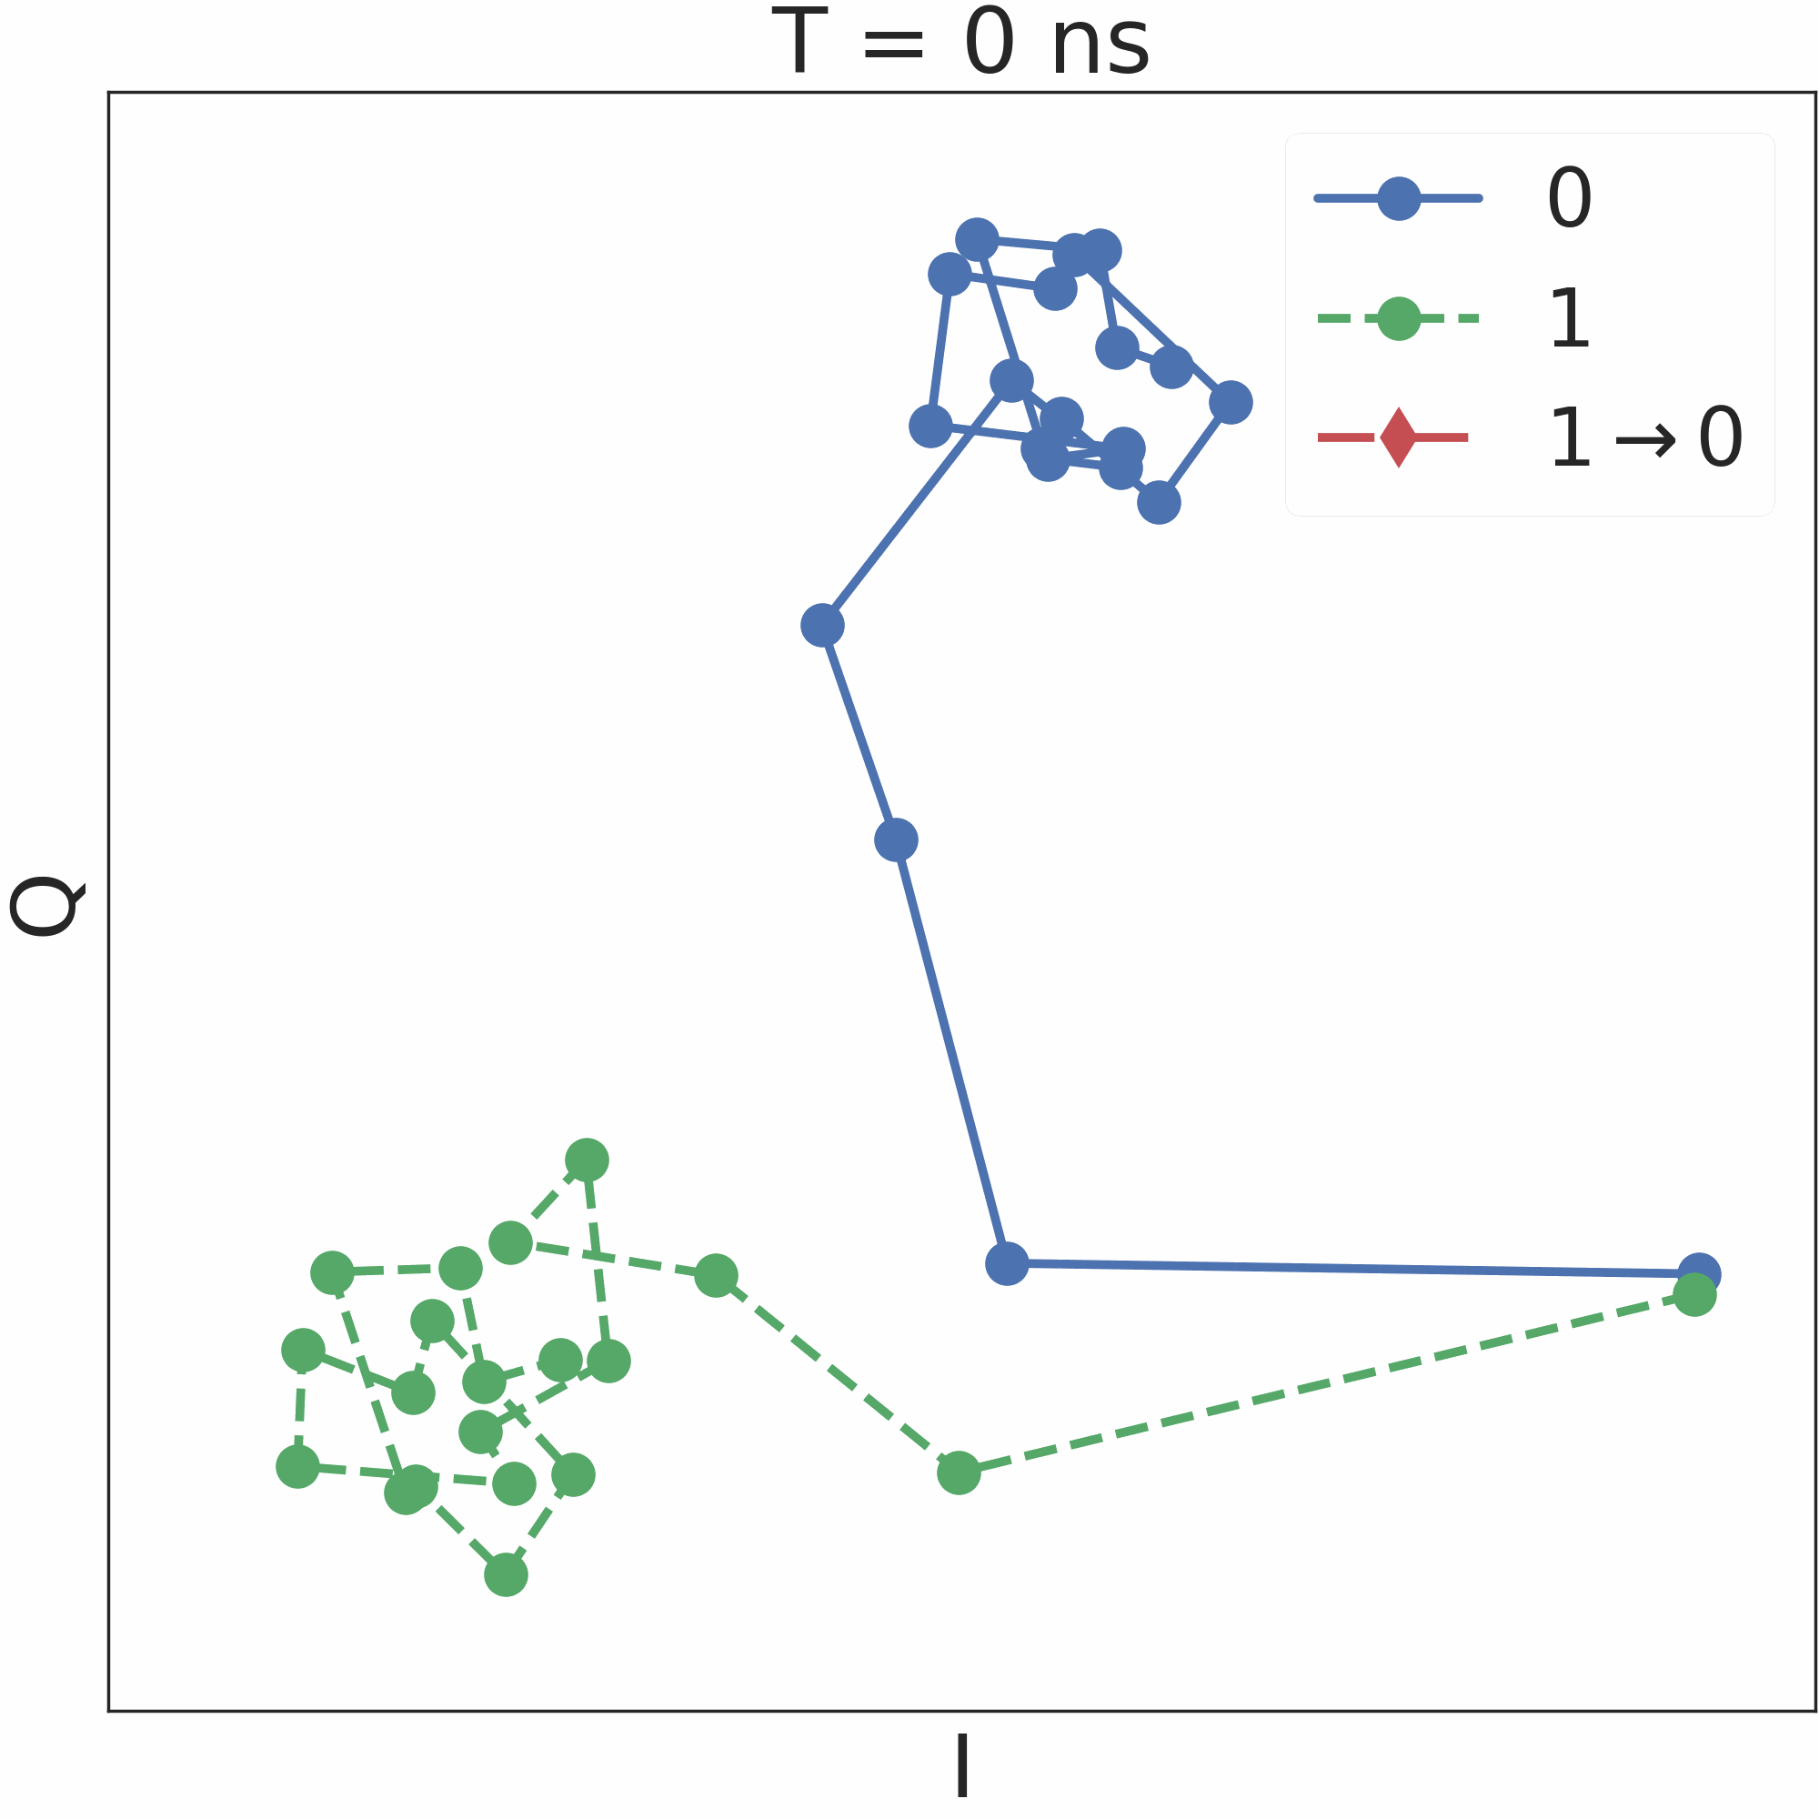
Detecting Relaxations

Slide 14
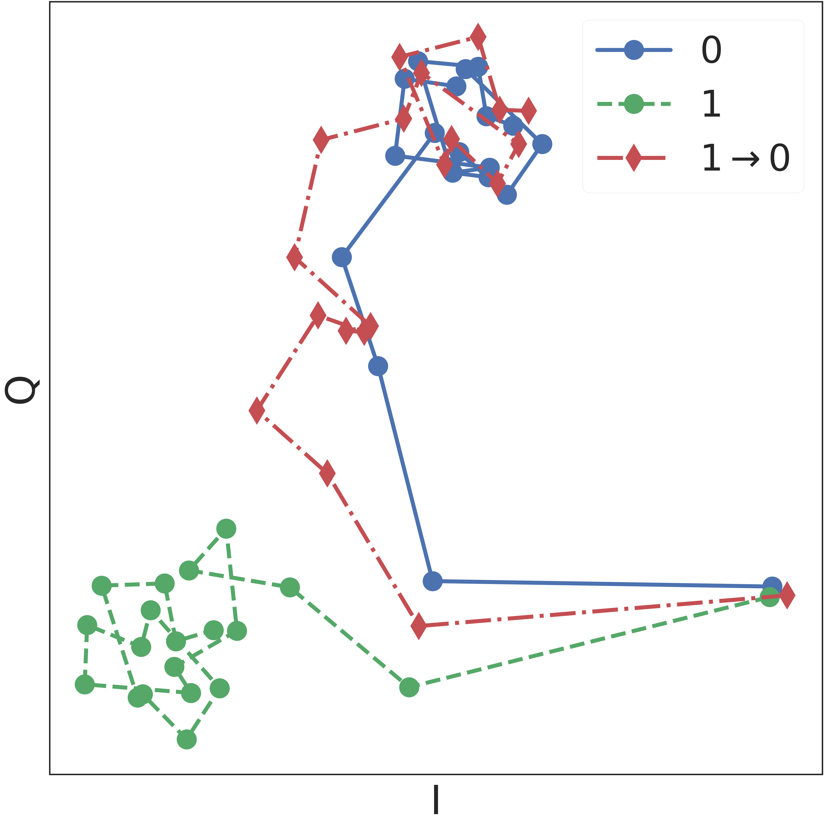
Relaxations can be detected
Traces corresponding to relaxations are distinct ⇒ can be detected using template matching algorithms.

Slide 15
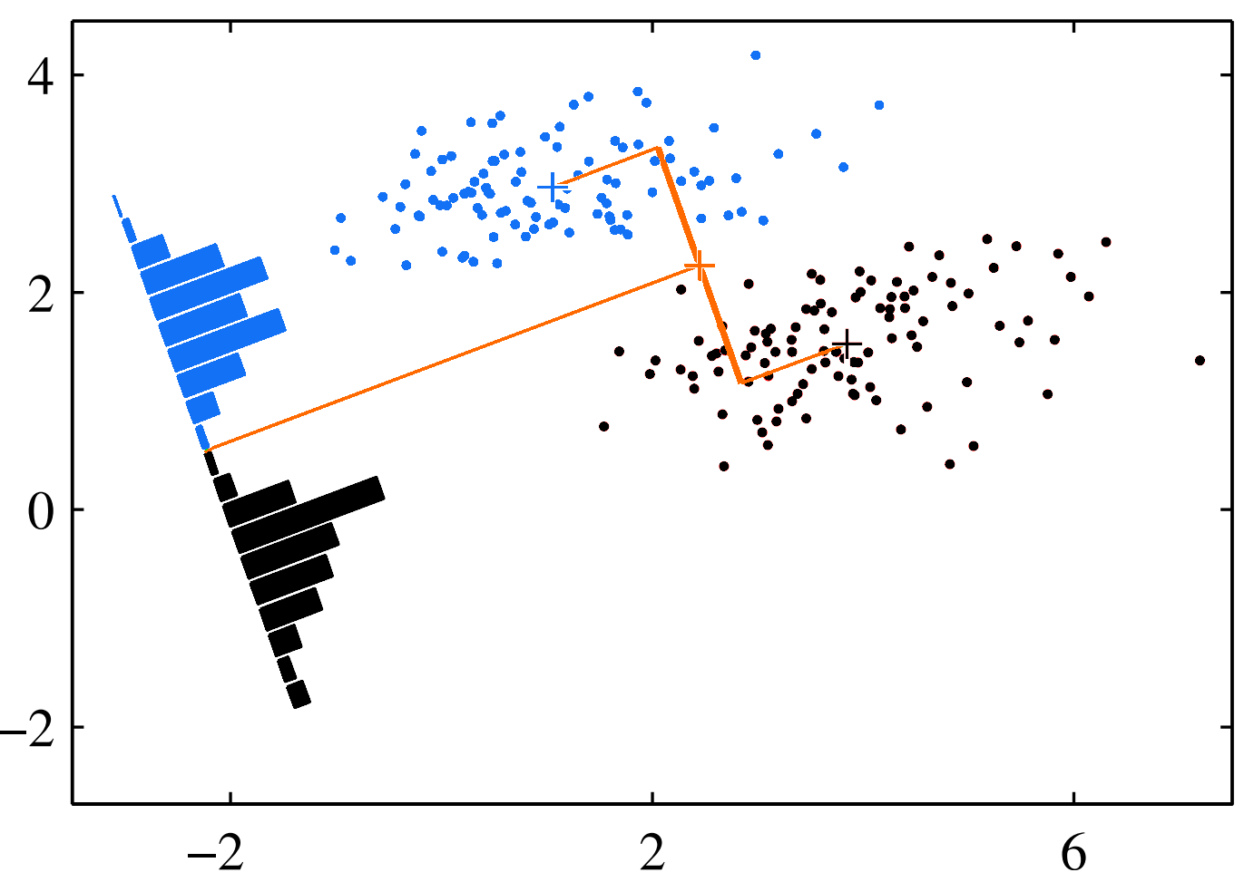
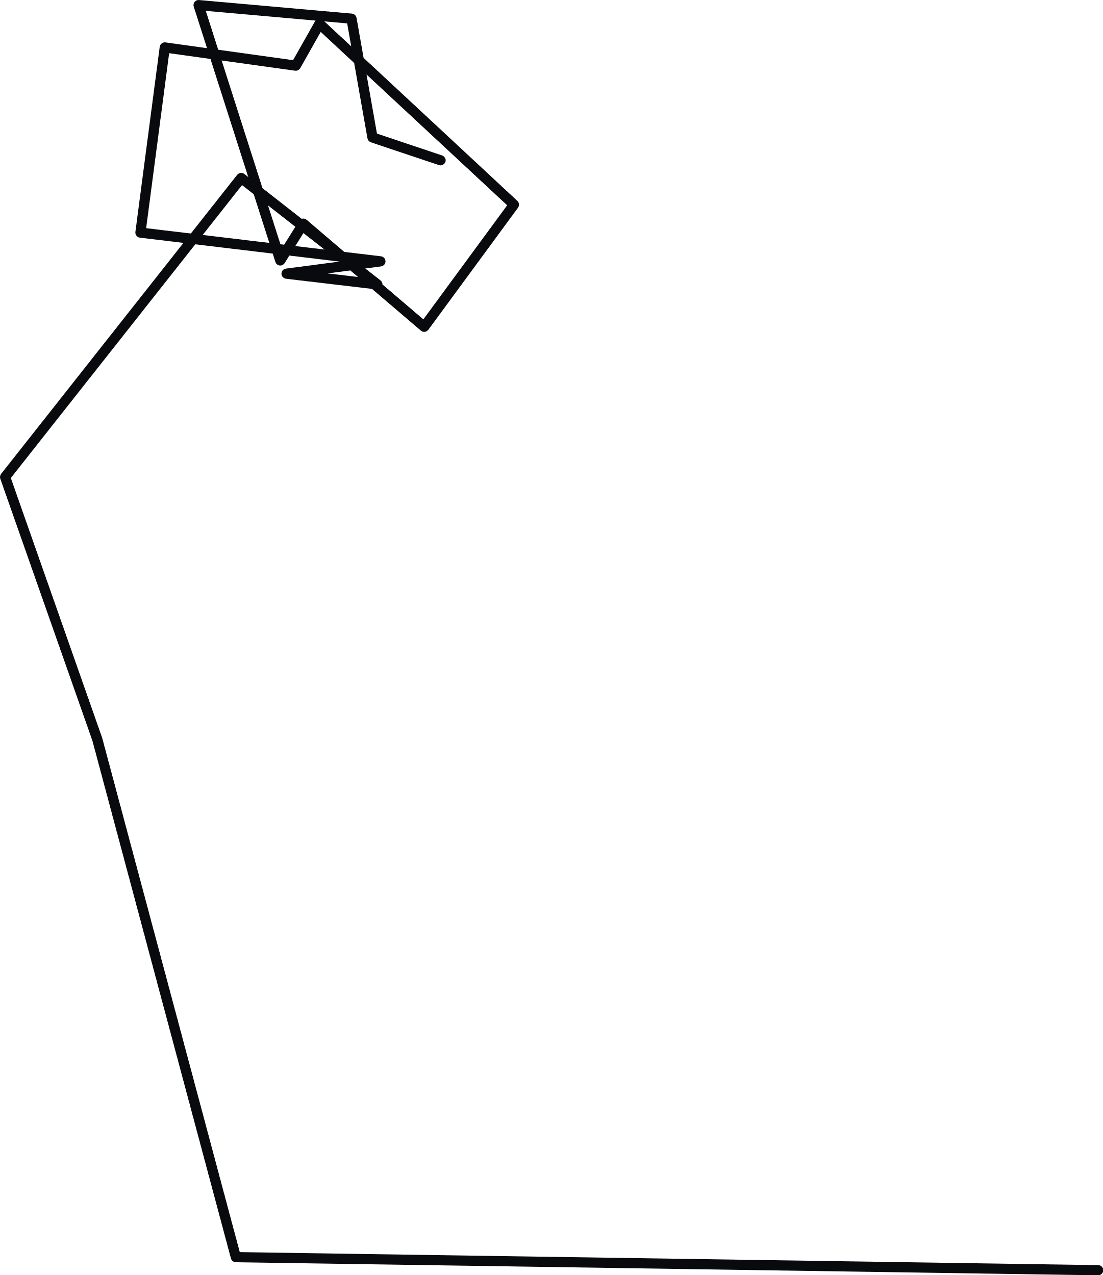
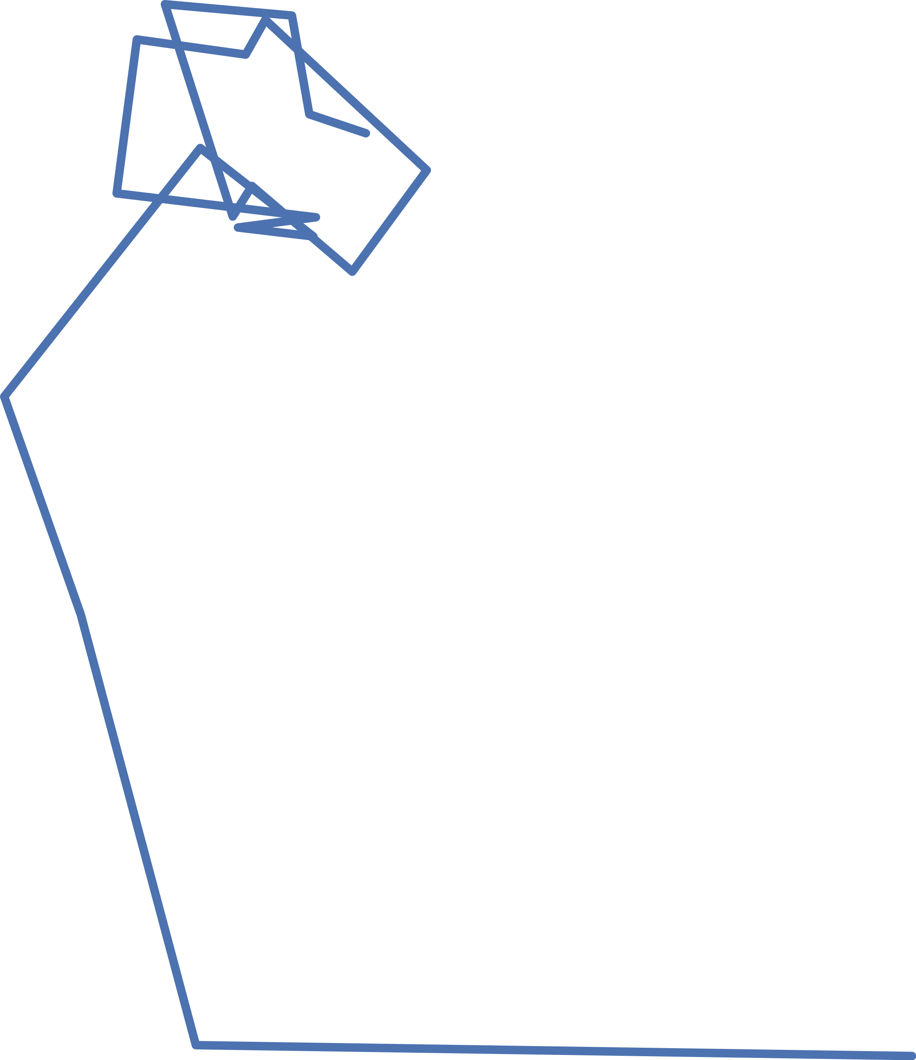
Template Matching
Matched filter a.k.a.
Fisher’s Linear Discriminant
Template matching
Matched filter
Match /
No match
Input
Template matching with matched filters
Template

Slide 16
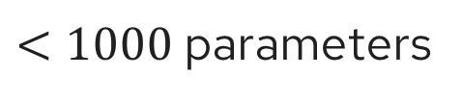
Our Proposed Design - HERQULES
MF
Use traces corresponding to relaxations for
training Relaxation Matched Filters (RMF).
0 or 1?
MF
NN
RMF
Readout
Signal
0 - 31
RMF
$<1000$ parameters
True 0 or 1→0?

Slide 17
Hardware Utilization
If an FPGA large enough to fit the baseline is used, HERQULES can fit the hardware required for readout of >10x more qubits.
¹Lienhard, Benjamin, et al. "Deep-neural-network discrimination of multiplexed superconducting-qubit states." Physical Review Applied 17.1 (2022): 014024.

Slide 18
Readout Accuracy
 | Baseline¹ | HERQULES
Qubit 1 | 0.969 | 0.985
Qubit 2 | 0.753 | 0.754
Qubit 3 | 0.943 | 0.966
Qubit 4 | 0.946 | 0.962
Qubit 5 | 0.97 | 0.989
Ƒ_{5Q} | 0.9122 | 0.9266
16% relative improvement
¹Lienhard, Benjamin, et al. "Deep-neural-network discrimination of multiplexed superconducting-qubit states." Physical Review Applied 17.1 (2022): 014024.

Slide 19
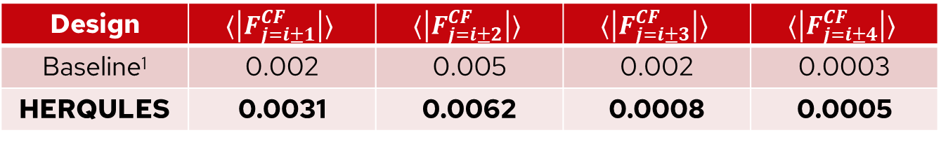
Readout Crosstalk Mitigation
Cross-Fidelity $F_{i, j}^{CF}= 1 − [P(e_{i}|0_{j}) + P(g_{i}|1_{j})], (i≠j)$ → Lower is better
Design | $$⟨\left|F_{j=i±1}^{CF}\right|⟩$$ | $$⟨\left|F_{j=i±2}^{CF}\right|⟩$$ | $$⟨\left|F_{j=i±3}^{CF}\right|⟩$$ | $$⟨\left|F_{j=i±4}^{CF}\right|⟩$$
Baseline¹ | 0.002 | 0.005 | 0.002 | 0.0003
HERQULES | 0.0031 | 0.0062 | 0.0008 | 0.0005
¹Lienhard, Benjamin, et al. "Deep-neural-network discrimination of multiplexed superconducting-qubit states." Physical Review Applied 17.1 (2022): 014024.

Slide 20
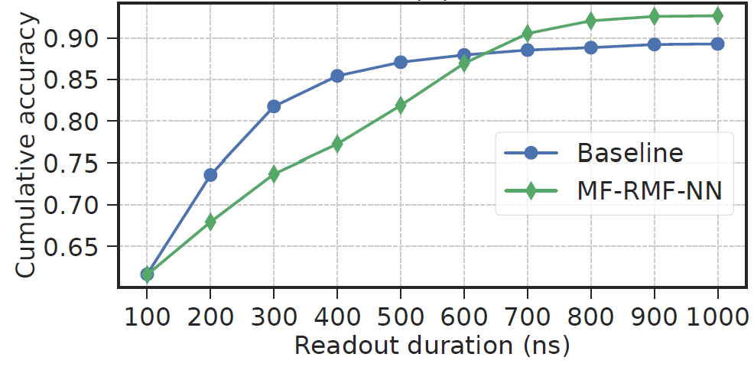
Enabling Faster Readout
HERQULES can achieve higher readout accuracy with
a shorter readout duration without requiring re-training.
1
HERQULES
¹Lienhard, Benjamin, et al. "Deep-neural-network discrimination of multiplexed superconducting-qubit states." Physical Review Applied 17.1 (2022): 014024.

Slide 21
Conclusions
Existing state-of-the-art classifiers expensive to implement on hardware.
We present a classifier that uses matched filters with a small, lightweight neural network to mitigate crosstalk that can be easily implemented on hardware.
Our proposed classifier achieves a 16.4% relative improvement in the combined state assignment accuracy.

Slide 22
Questions?

Slide 24
Backup

Slide 25
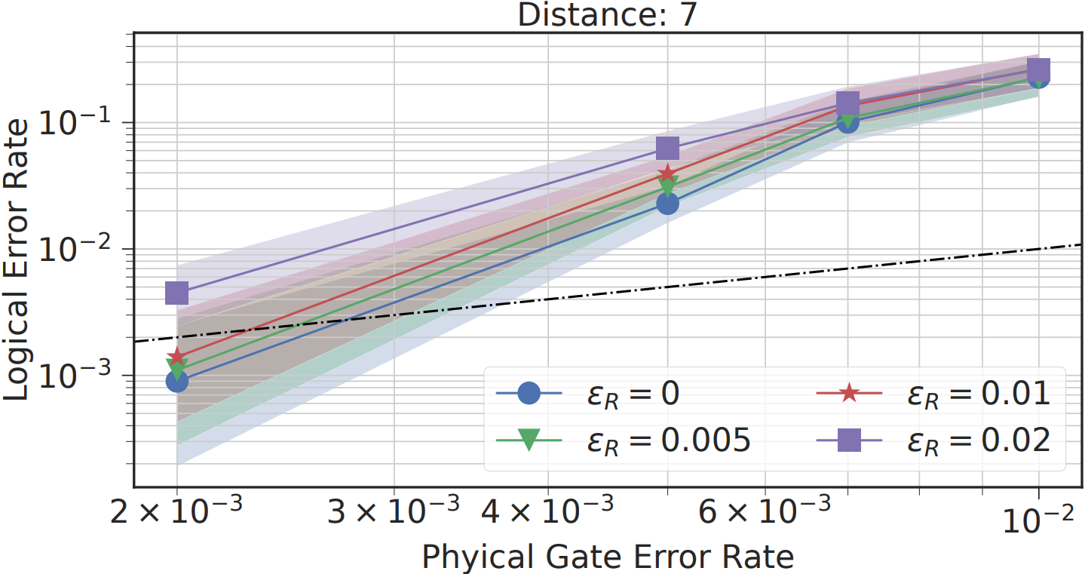
Surface Code Simulations

Slide 26
Matched Filters
Matched Filter (or Fisher’s linear discriminant): Optimal integration envelope to reduce data dimensionality and enable efficient qubit state discrimination
Envelope for single qubit:
⟨ground-state readout trace — excited-state readout trace⟩
var(ground-state readout trace — excited-state readout trace)

Slide 27
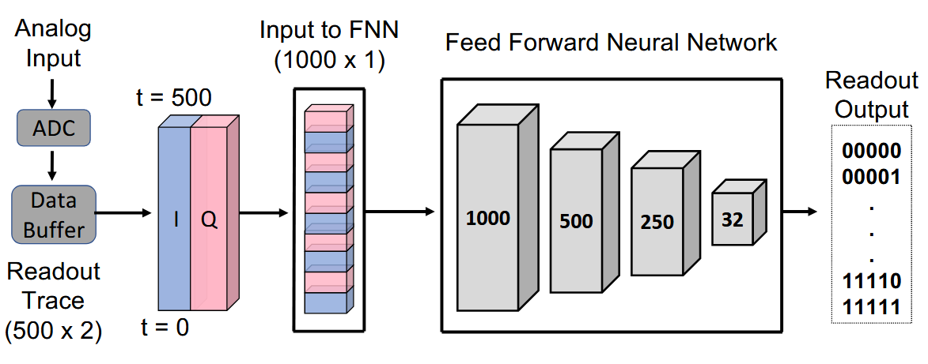
Baseline Classifier

Slide 28
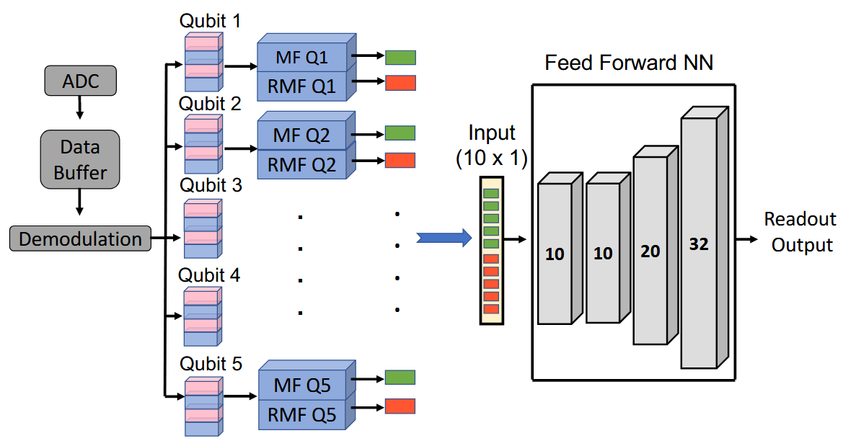
HERQULES

Slide 29
Accuracy
Design | Qubit 1 | Qubit 2 | Qubit 3 | Qubit 4 | Qubit 5 | F_{5Q} | F_{4Q}
Baseline¹ | 0.969 | 0.753 | 0.943 | 0.946 | 0.97 | 0.912 | 0.957
MF | 0.968 | 0.734 | 0.891 | 0.934 | 0.956 | 0.892 | 0.937
MF-SVM | 0.968 | 0.738 | 0.895 | 0.928 | 0.953 | 0.892 | 0.936
MF-NN | 0.969 | 0.740 | 0.901 | 0.936 | 0.957 | 0.896 | 0.940
MF-RMF-SVM | 0.981 | 0.752 | 0.959 | 0.957 | 0.986 | 0.923 | 0.970
MF-RMF-NN | 0.985 | 0.754 | 0.966 | 0.962 | 0.989 | 0.927 | 0.975
¹Lienhard, Benjamin, et al. "Deep-neural-network discrimination of multiplexed superconducting-qubit states." Physical Review Applied 17.1 (2022): 014024.

Slide 30
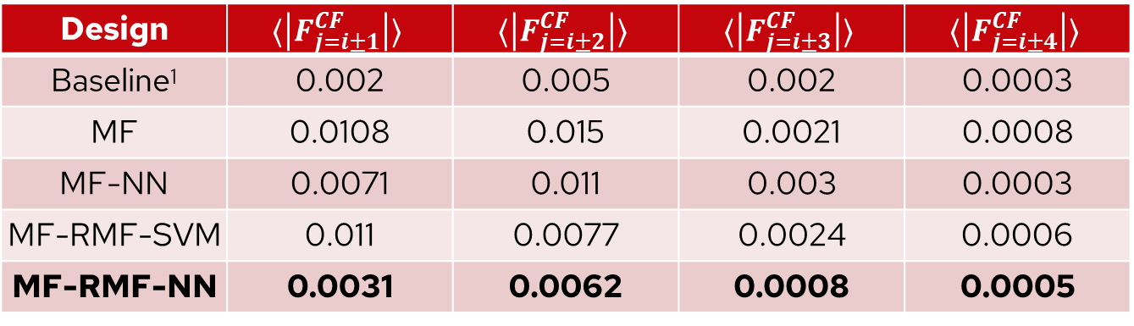
Crosstalk Mitigation
Design | $$⟨\left|F_{j=i±1}^{CF}\right|⟩$$ | $$⟨\left|F_{j=i±2}^{CF}\right|⟩$$ | $$⟨\left|F_{j=i±3}^{CF}\right|⟩$$ | $$⟨\left|F_{j=i±4}^{CF}\right|⟩$$
Baseline¹ | 0.002 | 0.005 | 0.002 | 0.0003
MF | 0.0108 | 0.015 | 0.0021 | 0.0008
MF-NN | 0.0071 | 0.011 | 0.003 | 0.0003
MF-RMF-SVM | 0.011 | 0.0077 | 0.0024 | 0.0006
MF-RMF-NN | 0.0031 | 0.0062 | 0.0008 | 0.0005

Slide 31
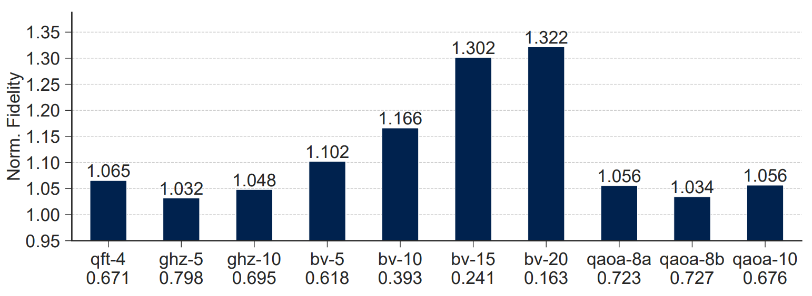
Noisy Simulations

Slide 32
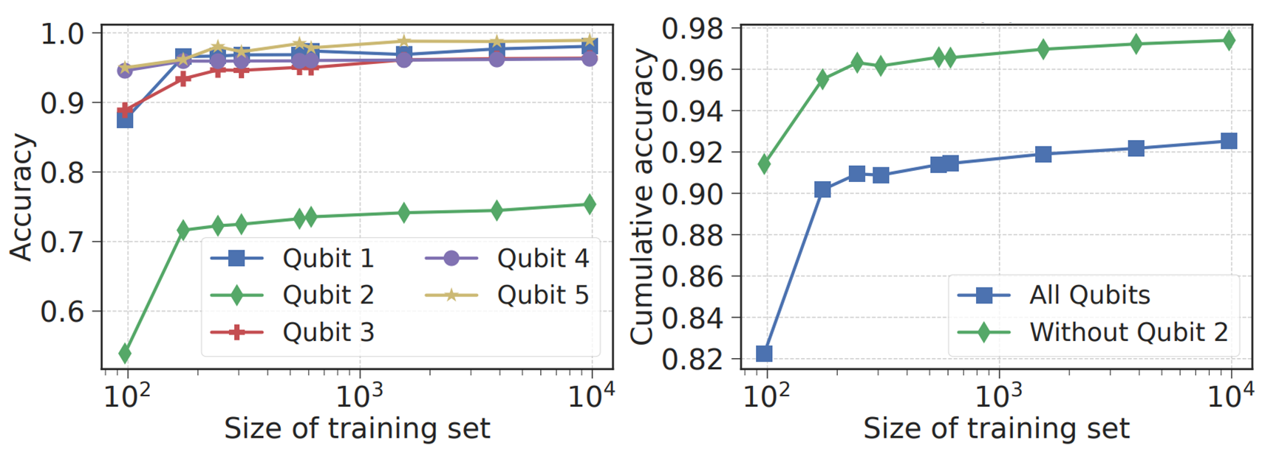
Training Curve

Slide 33
Mitigate Hardware Errors
Scale
Control Architecture
New Materials, Devices, …
Current NISQ
(100+ Qubits)
Near Future NISQ
(1000 Qubits)
Dream
(100,000 Qubits)

